Slide 1
Audio compression Delivered to: Dr. Marwa

Slide 2




Our team
Abdelrahman ghoniem
Mohammed Abdelmotaleb
Mohammed Osama
CS-G4
CS-G7
CS-G6

Slide 3
01
02
03
Introduction
Overview
Libraries used
04
05
06
Algorithm used
resources
code
Agenda
A small introduction about audio compression
Types,factors affecting,challenges
Describing libraries used in the implementation phase
Describing algorithm used in the implementation phase
Mention resources used in researching through this process
Showing how to implement an audio compression app

Slide 4
INTRODUCTION

Slide 5
Introduction
An audio compressor is one of the sound processing devices, and is often used in live sound systems in mosques, theaters, recording studios, and in most audio projects. The function of this device is to maintain the sound level within upper and lower limits.and immersive formats.

Slide 6
OVERVIEW

Slide 7
TYPES OF COMPRESSORS
Optical compressors
Universal Audio LA-2A, WAVES CLA-2A,
Softube TLA-100A,CL1B
VCA Compressors
SSL G-Master Buss Compressor, Waves SSL G-Master Buss Compressor, Cytomic The Glue, SSL Native Bus Compressor

Slide 8
TYPES OF COMPRESSORS
FET Compressors
Universal Audio 1176LN, Waves CLA-76, IK Multimedia T-RackS Black 76, Plugin Alliance Lindell 7X-500
Tube Compressors
UAD Fairchild Collection, Arturia TUBE-STA, Waves PuigChild Compressor

Slide 9
TYPES OF COMPRESSORS
Digital Compressors
FabFilter Pro-C 2, TDR Kotelnikov, Klanghelm DC8C

Slide 10
FACTORS AFFECTIONG COMPRESSOR
Threshold- 25%
Release time - 25%
controls how quickly the compressor returns to normal operation after the input signal drops.
Determines when the compression begins
Attack time- 25%
Makeup gain - 26%
determines how quickly the compressor reduces the gain when a signal becomes too loud
allows you to boost the compressed signal to achieve the desired output level
If you're looking for a reference in terms of standard or recommended values, these can vary based on the audio material, the desired effect, and personal preference.

Slide 11

Challenges affecting audio compression field
if a lossy compression method is used, the quality is reduced. Lossless compression methods exist and they achieve about 50% reduction in size.
Lossy compression methods can achieve 10:1 compression with undetectable loss of fidelity.

Slide 12
Libraries used
matplotlib
pydub
numpy
Used for visualizing the original, compressed, and the final compressed audio signal
Used for loading, processing, and exporting audio files
Used for efficient handling of audio samples and creating time axis for plotting the audio signals

Slide 13
Algorithm used

Slide 14
Algorithm Used: Dynamic Range Compression Algorithm
#01
#02
#03
#04
Load the audio file using pydub.
Visualize the original audio signal using matplotlib.
Apply dynamic range compression using the compress dynamic range method.
Visualize the compressed audio signal.

Slide 15
Next steps
#05
#06
#07
#08
Apply makeup gain to the compressed audio signal.
Visualize the final compressed audio signal.
Export the compressed audio to a specified output file.
Play the compressed audio.

Slide 16
resources

Slide 17
Resources
Splice.com
Fabfilter.com
Quora.com
Soundonsound.com

Slide 18
code

Slide 19
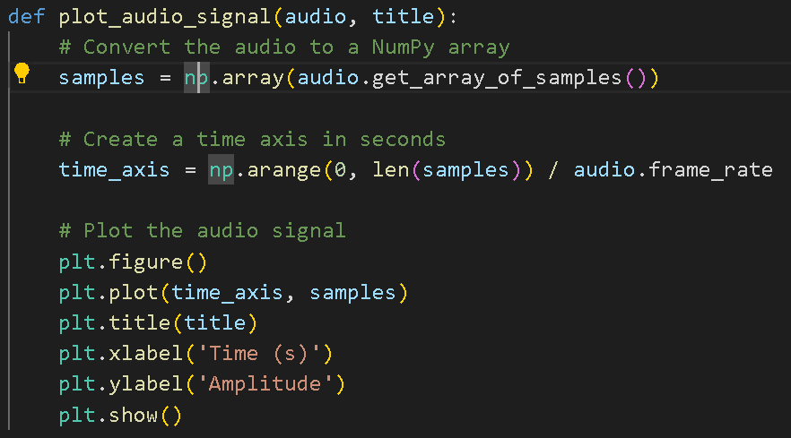
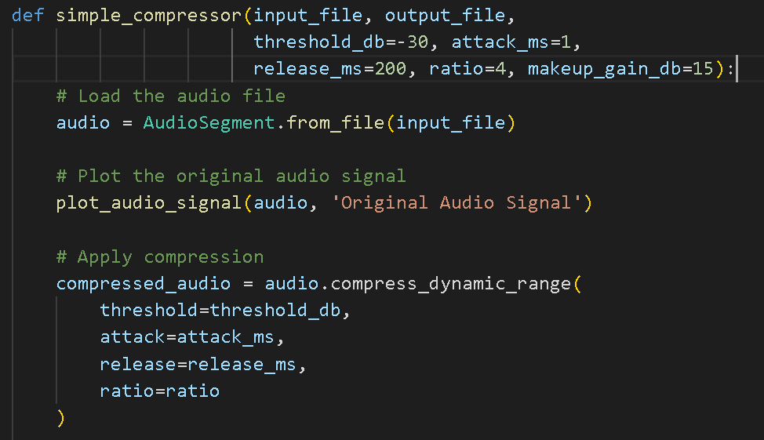
Code
Defining the audio in an array
Defining the compressor preferences

Slide 20
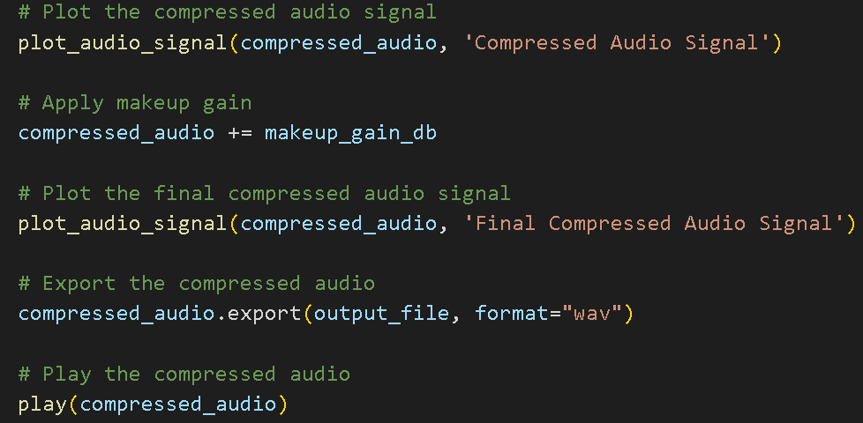
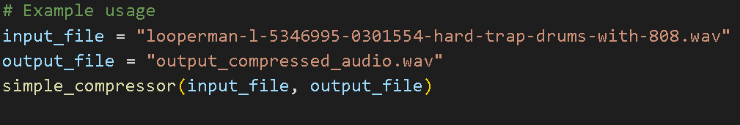
Code
plotting the audio signal , Appling makeup gain, exporting as wav
Importing a file and exporting in a new file

